Slide 1
Chapter 3. Process Description and Control
CSci 474: Operating Systems Instructor: Dr. Jun Kong

Slide 2
Process
A program in execution
An instance of a program running on a computer
The entity that can be assigned to and executed on a processor
A unit of activity characterized by the execution of a sequence of instructions, a current state, and an associated set of system resources

Slide 3
Process
When a program is executed, a process is created.
More than one process can reside in memory at the same time.
The CPU may switch between processes as they run.
  From the process’ viewpoint, the CPU occasionally executes its code.
  From the CPU’s viewpoint, it executes some code of one process, then some code of the next process, etc.

Slide 4
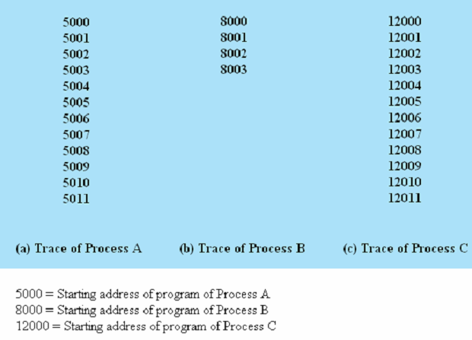
Process Trace
In order to prevent monopolizing, we assume OS only allows a process to continue execution for a maximum of 6 instruction cycles.
Dispatcher: 100-105

Slide 5
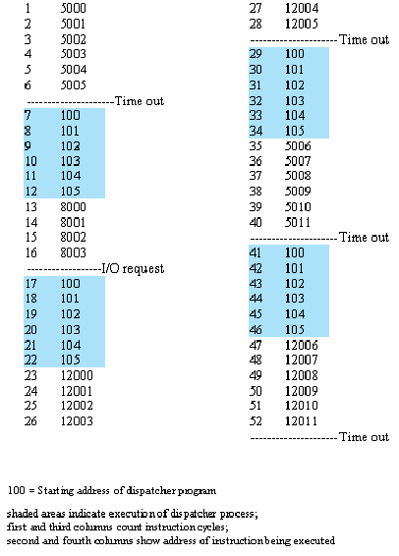

Slide 6
Process Elements
Identifier: a unique identifier
State: running, ready and …
Priority: priority level relative to other processes
Program counter: the address of next instruction
Memory pointers: pointers to the program code and data
Context data: data present in registers in the processor
I/O status information: I/O devices assigned to this process, a list of files and so on
Accounting information: processor time used and so on

Slide 7
Process Control Block
Contains the process elements
Created and managed by the operating system
Allows support for multiple processes

Slide 8
Process creation
When a new process is created, the operating system builds the data structures that are used to manage the process, and allocates space in main memory for the process.
Reasons
  New batch job submitted.
  Interactive Logon occurred.
  OS creates one for some service (like printing).
  Spawned by an existing process.

Slide 9
Spawning a Process
When one process creates another, the process is said to spawn the new process.
A spawned process is said to be a child process, the process that spawned it is said to be the parent process.

Slide 10
Process termination
1. Normal completion
2. Time limit exceeded: the process has run longer than the specified total time
  total elapsed time, amount of time spent executing, or time since the last user input
3. Memory unavailable: the process requires more memory than the system can provide
4. Bounds violation: the process tries to access a memory location that is not allowed to use
5. Protection error: The process attempts to use a resource that is not allowed to use or tries to use it in an improper fashion
6. Arithmetic error: the process tries a prohibited computation (e.g., divide by zero)
7. Time overrun: the process has waited longer than a specified maximum for a certain event to occur

Slide 11
Process termination
8. I/O failure: an error occurs during input or output (e.g., file not found, failure to R/W)
9. Invalid instruction: the process attempts to execute a nonexistent instruction (e.g., the process tries to execute data)
10. Privileged instruction: the process attempts to use an instruction reserved for the operating system
11. Data misuse: a piece of data is wrong or is not initialized
12. Operating system intervention: for some reason, the operator or the operating system has terminated the process (e.g., if a deadlock exists)
13. Parent termination: when a parent terminates, the operating system may automatically terminate all of the offspring of that parent
14. Parent request: a parent has the authority to terminate any of its offspring

Slide 12
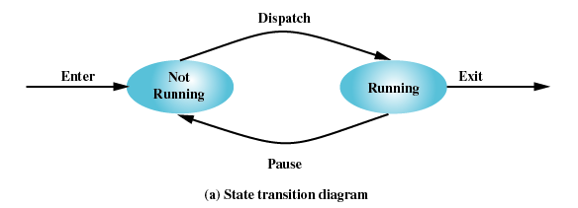
Two-State Process Model
Process may be in one of two states
  Running
  Not-running

Slide 13
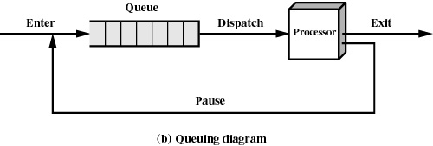
Process Queue
Queue of not-running processes.
www.menti.com: 58679962

Slide 14
Five State model
The two-state model uses one queue for all not-running processes
  Ready to run
  blocked

Slide 15
Five state model
Split the not-running state into two states: ready and blocked
Five state model
  Running: process is executing
  Ready: process is ready to execute
  Blocked: process is waiting for an event
  New: process created but not yet loaded
  Exit: process is exiting

Slide 16
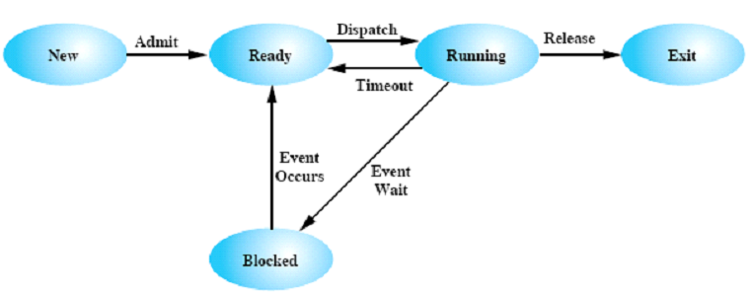
New state:
  The New state corresponds to a process that has just been defined. It is not loaded into memory yet.
  The OS may limit the number of processes in the system.
Exit state:
  It is no longer eligible to execute
  The data structure for a terminated process remain long enough for support and accounting programs to extract information

Slide 17
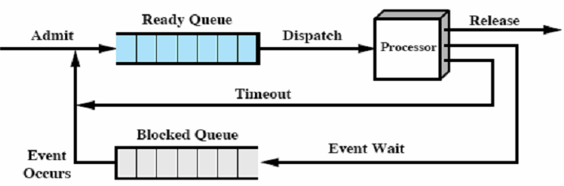
A new process is moved to the ready queue.
A process is picked to run from the ready queue.
A running process moves either to the blocked queue or ready queue, or terminates.
When a blocking event occurs, all processes blocked waiting on the event are moved to the ready queue.
There also may be separate ready queues for different process priorities.

Slide 18
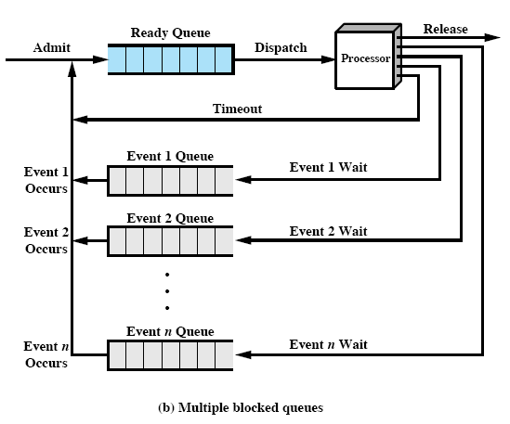
www.menti.com: 32194365

Slide 19
Suspended processes
Processor is faster than I/O so all processes could be waiting for I/O
Swap these processes to disk to free up memory
Blocked state becomes suspend state when swapped to disk
  Blocked/Suspend: suspended and awaiting an event.

Slide 20
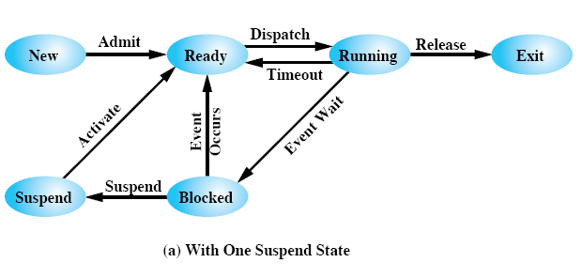
www.menti.com: 74192392

Slide 21
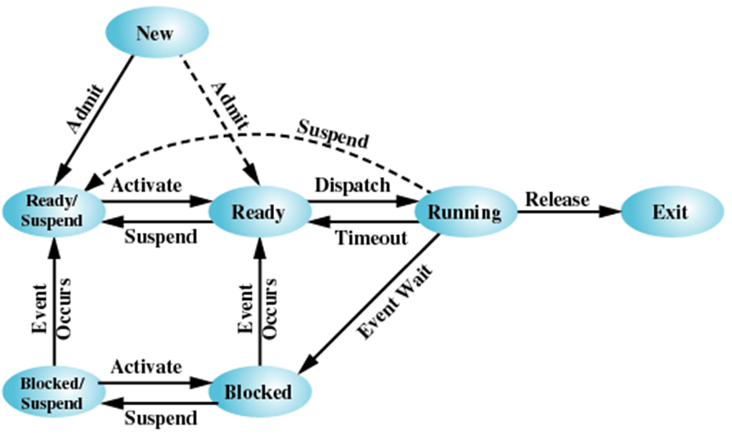
www.menti.com: 42438993

Slide 22
Reason for process suspension
Swapping: for freeing main memory.
OS Reason: if OS thinks process is causing a problem (for example, deadlock).
User request: to debug, the user may suspend execution, examine its activity, and resume execution.
Timing: if infrequently run (utility or accounting program).
Parent request: to examine a child process or its activity.

Slide 23
Suspend State
It is not immediately available for execution.
It may or may not be waiting on an event. (Blocking is not the same as suspending).
The process was suspended by an agent (itself, a parent, the OS).
The process stays suspended until the agent un-suspends it.

Slide 24
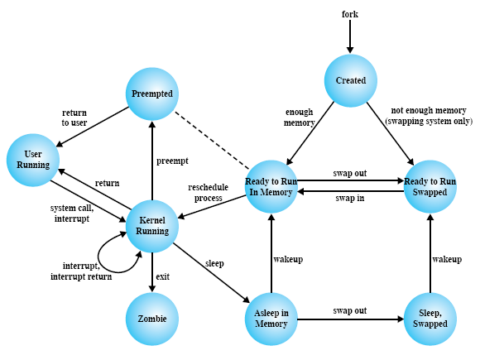

Slide 25
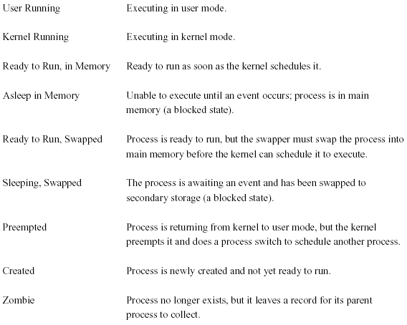

Slide 26
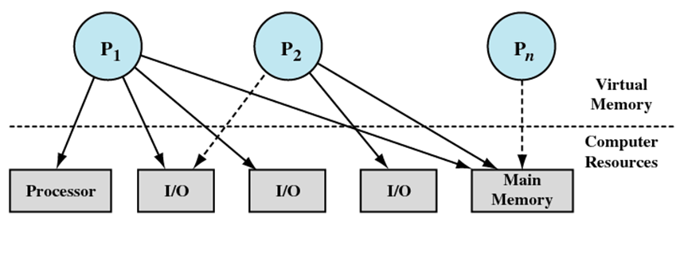
Processes and resources

Slide 27
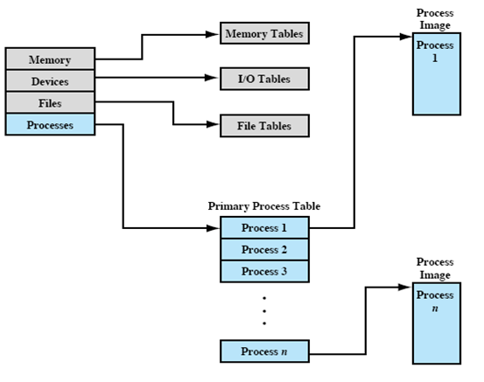
OS control structures
Information about the current status of each process and resource
Tables are constructed for each entity the operating system manages
  Memory tables
  I/O tables
  File tables
  Process tables

Slide 28
Memory Tables
Allocation of main memory to processes.
Allocation of secondary memory to processes.
Protection attributes of blocks of main or virtual memory (for shared blocks for example).
Information needed to manage virtual memory.

Slide 29
I/O Tables
Keeps track of availability or assignment to a process
I/O device status or I/O operation status
Location in main memory being used as the source or destination of the I/O transfer

Slide 30
File Tables
Existence of files
Location in secondary storage
Current status
File attributes

Slide 31
Process Table
Where process is located
Information about each process
  The information is maintained in a data structure called a Process Control Block (PCB)

Slide 32
Process image
When a program is loaded into memory, it is not just the executable code that is loaded.
The program will also need memory to store its data and its stack
The program is also associated with a PCB

Slide 33
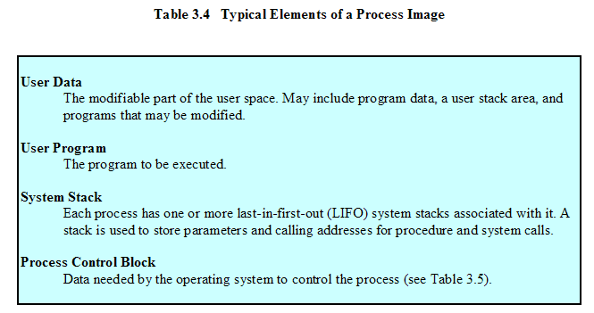
Process image

Slide 34
Role of PCB
PCB is the most important data structure in the OS.
It contains all of the information the OS needs to know about the process.
It is used by almost every module in the OS.
The set of PCBs defines the state of the OS.
This means the PCBs must be handled carefully, since if any routine corrupts them then all is lost.

Slide 35
Process control block
Process identification
Processor state information
Process control information

Slide 36
Process identification
Numeric identifications are stored with the process control block
  The process
  The parent of the process
  The user of the process

Slide 37
Processor state information
User visible registers
Control and status registers
Stack pointer

Slide 38
Process control information
Scheduling and State Information:
  Process state: ready, running, waiting, …
  Priority: high, low, numeric value, etc.
  Scheduling-related information: for example, time process has been waiting
  Event: ID of event being waited for.
Data Structuring: pointers to other processes, such as parent-child, queuing, or other structure.
Interprocess Communication: flags, signals, messages
Process Privileges: for resources or memory
Memory Mgmt: for segmented or virtual memory
Resources Ownership and Utilization: resources currently owned or history information for the scheduler.

Slide 39
Modes of execution
Kernel mode (system mode or control mode): privileged mode having complete control of system, can execute privileged instructions, all registers and all memory
User mode: running user programs

Slide 40
Changing modes
Switch from process to interrupt handler
Typically, the PSW has a mode bit to indicate the current mode.
Upon certain events, the processor switches to kernel mode and the bit is set.

Slide 41
When to switch a process
Clock interrupt
  process has executed for the maximum allowable time slice
I/O interrupt
Memory fault
  memory address is in virtual memory so it must be brought into main memory
Trap
  error or exception occurred
  may cause process to be moved to Exit state
Supervisor call
  such as file open

Slide 42
Process Switch
Save context of processor
Update PCB for process to non-running state.
Move PCB of process to an appropriate queue for the state.
Select another process to run (runs scheduler routine)
Update the PCB of the selected process to the running state.
Update memory-management data structures.
Restore state of newly selected process.

Slide 43
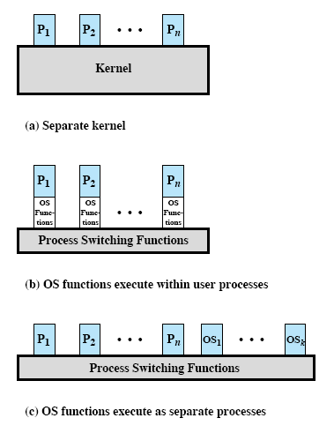

Slide 44
Nonprocess Kernel
This approach executes the kernel outside of any process.
The OS has its own region of memory and its own stack.
The OS is a separate entity which manages user processes.
This is a traditional approach.

Slide 45
Execution within User Processes
OS software runs within context of a user process.
Kernel’s program, data & stacks are added to the image of the calling process.
Process executes in privileged mode when executing the part that has the operating system code.
Key benefit that interrupts are handled within the same process (mode switch instead of process switch).

Slide 46
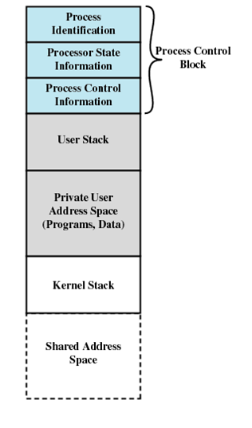

Slide 47
Process-Based OS
OS supports two kinds of processes, user processes and system processes.
All processes can then be managed according to priority with some OS functions being low priority and others being high.
Useful in multi-processor or multi-computer environment where OS processes may exploit parallelism.

